Slide 1

Happiness and socio-economic indicators

Slide 2
Agenda
Rsearch Questions
Source Selection
Data Architecture
Results
Boxplot, standard deviation, confidence intervals
Conclusions

Slide 3

Research Questions
What are the happiest countries/regions?
2) What factors are more correlated with happiness score?

Slide 4
Source Selection
Happiness Rank Report
World Bank
Eurostat
WEF
Open Science Framework
WHO
WVS
Uppsala conflict data program
.

Slide 5
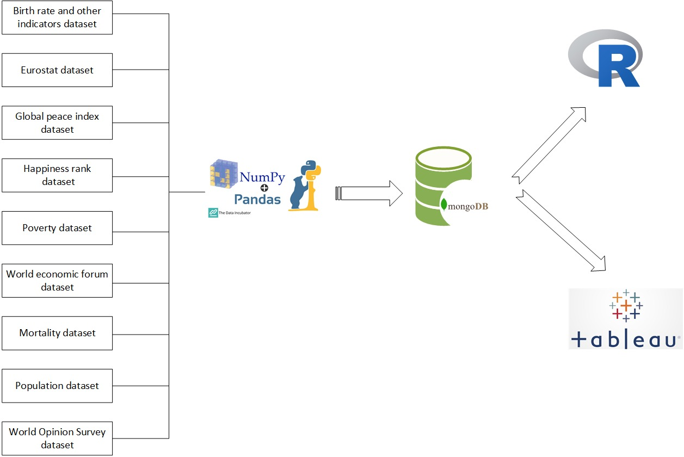
Data Architecture

Slide 6
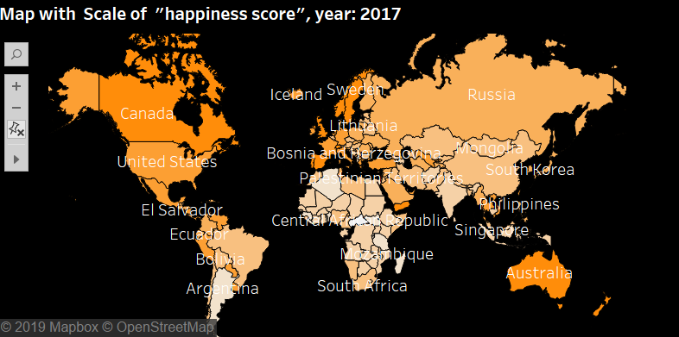
Results

Slide 7
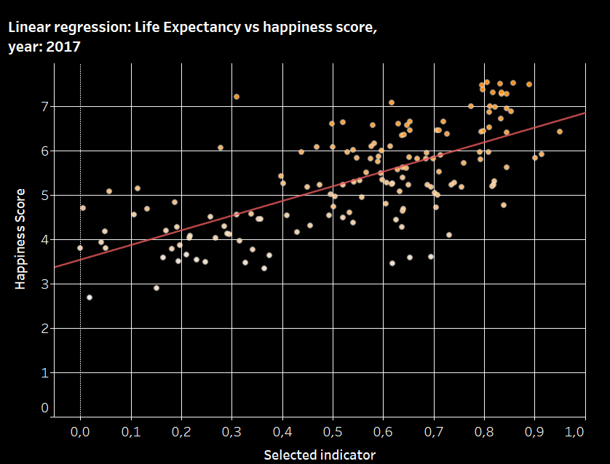
Results

Slide 8
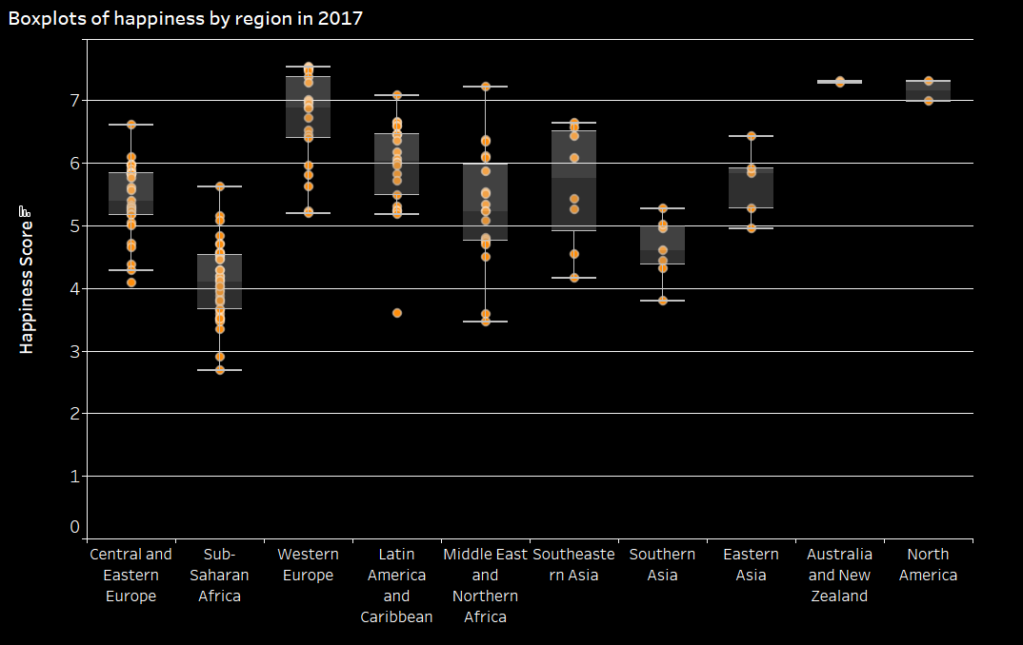
Boxplot, standard deviation, confidence intervals

Slide 9
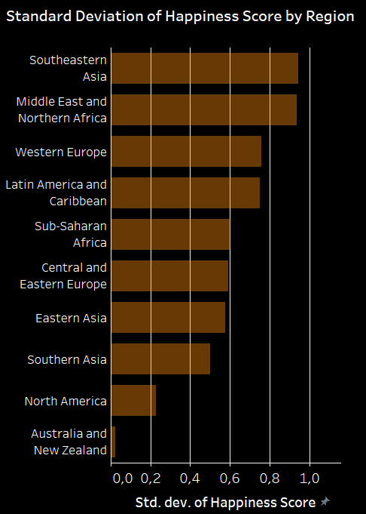
Boxplot, standard deviation, confidence intervals

Slide 10
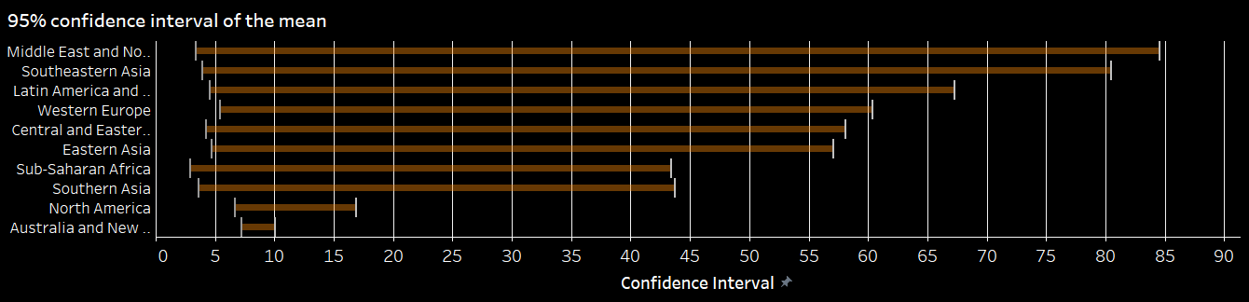
Boxplot, standard deviation, confidence intervals

Slide 11
Conclusions
Many other possible analysis
Other vizs (creativity)
Correlation with many socio-economic variables
Life expectancy (R-squared = 0,4716, p-value <0,001)

